Slide 1

Narnarayan Shastri Institute Of Technology
Department of Computer Engineering Academic Year: 2015 – 2016
E-Intercarrier
Presented By Guided By-
Patel Kinnari R(120340131002) Prof. Saumil Patel
Parekh Urvashi S.(120340131007) Assistant Professor
Patel Jaimin J.(120340131054)

Slide 2
Outlines
Introduction
Literature Review
Modules and Functionalities
Tools/Technology for Implementation
Analysis of system
Class Daigaram
Data Dictionary
Test Cases
Implementation Snapshots
References

Slide 3
Introduction
E-Intercarrier provides stock-tacking and inventory management in most simplistic way. be it for your home or for the business. it will help you easily track your inventory.
It also helps in managing purchase orders and sales orders. You can send those to suppliers or Stores. Soon you can manage business expenses too. so it is a complete app to run your business from mobile.
Software of project management to the creation and development of large scale of inventory stock and Inward stock, utilize order and provides Reports(sales, dead stock, paid stock ,return stock, replaced stock).

Slide 4
Need of the project
Difficult to maintain a large size inventories for production and sales operation.
Difficult to manage stock of the warehouse and stores.
Difficult to handle payment and billing of the different store
Difficult to manage return ,replaced, dead stock

Slide 5
Modules and Functionalities
Store Employee
Warehouse Manager
Business Manager(Admin)

Slide 6
Tools/Technology for Implementation
Front End : HTML5, CSS3, Java Script, AJAX, JSP, JQUERY
Programming Language : JAVA-J2EE
Architecture : MVC 3-Tier
Framework : Hibernate
Database : Dynamo DB
Tools : Eclipse Luna, Dream Viewer CS

Slide 7
Analysis of system
In Store needs such things at a time so they have to inform to the Warehouse Manager.
Time consuming .
Internally all Stores Employees are not connected with each other.
Reduction in sharing information and customer services.
Difficult to Maintain a larg data.
Employees less satisfaction.

Slide 8
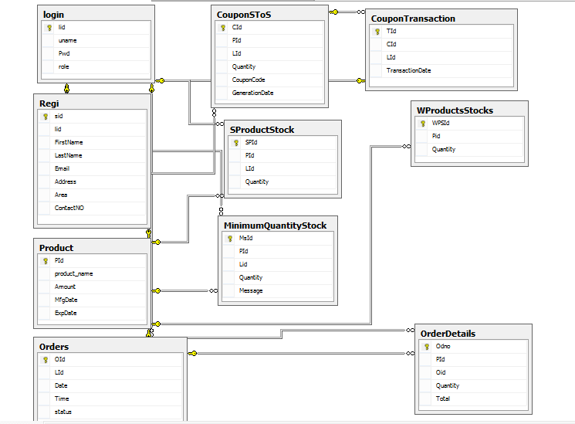
Class Diagram

Slide 9
Data Dictionary
1) Login
Field | Data type | Constraints | Description
LId | Int | Primary key | Primary Key of login
Uname | Varchar(100) | Not null | User name
Password | Varchar(30) | Not null | Password for login
Roll | Varchar(20) | Not null | Identify user

Slide 10
2) Registration
Field | Data type | Constraints | Description
StoreId | Int | Primary key | Primary Key of store registration key
Lid | Int | Foreign key | Primary key (Login)
Name | Varchar(50) | Not null | Store name
Email | Varchar(100) | Not null | Email id of user
ContNo | Varchar(15) | Not null | Contact number of user
Address | Varchar(20) | Not null | Address of store
Area | Varchar(20) | Not null | Area of store

Slide 11
3) Warehouse Details
Field | Data type | Constraints | Description
WId | Int | Primary key | Primary Key of store registration key
Lid | Int | Foreign key | Primary key (Login)
Name | Varchar(50) | Not null | Store name
Email | Varchar(100) | Not null | Email id of user
ContNo | Varchar(15) | Not null | Contact number of user
Address | Varchar(20) | Not null | Address of store
Area | Varchar(20) | Not null | Area of store

Slide 12
4) Product
Field | Data type | Constraints | Description
PId | Integer | Primary key | Primary Key of product key
Product Name | Varchar(20) | Not null | Name of product
Amount | Long int | Not null | Price of product
ExpDate | Varchar(20) | Not null | Expire date of product
5) Order
Field | Datatype | Constraint | Description
Oid | Integer | Primary Key | Primary key of order
Lid | Integer | Foreign key | Primary key (Login)
OrderNo | Integer | Not null | Maintain the more than one order
Quantity | Integer | Not null | Quantity of product
Date of order | Date | Not null | Date of Order

Slide 13
6) Order Details
Field | Datatype | Constraint | Description
OdId | Integer | Primary key | Primary key of Order detail
PId | Integer | Foreign key | Primary Key( Product)
OrderNo | Integer | Not null | Maintain the more than one order
Quantity | Integer | Not null | Quantity of Order
7) Minimum Quantity Stock
Field | Datatype | Constraint | Description
MsId | Integer | Primary key | Primary key of minimum stock quantity
PId | Integer | Foreign key | Primary Key( Product)
Lid | Integer | Foreign key | Primary key (Login)
Quantity | Integer | Not null | Quantity of Order
Message | Varchar(20) | null | Alert for stock

Slide 14
8) Store Product Stock
9) Warehouse Product Stock
Field | Datatype | Constraint | Description
SpsId | Integer | Primary key | Primary key of store product stock
PId | Integer | Foreign key | Primary Key( Product)
Lid | Integer | Foreign key | Primary key (Login)
Quantity | Integer | Not null | Quantity of Order
Field | Datatype | Constraint | Description
WpsId | Integer | Primary key | Primary key of warehouse product stock
PId | Integer | Foreign key | Primary Key( Product)
LId | Integer | Foreign key | Primary key (Login)
Quantity | Integer | Not null | Quantity of Order

Slide 15
10) Coupon For Store to Store
Field | Datatype | Constraint | Description
CId | Integer | Primary key | Primary key of coupon
PId | Integer | Foreign key | Primary Key( Product)
LId | Integer | Foreign key | Primary key (Login)
Quantity | Integer | Not null | Quantity of Order
CouponCode | var | Not null | Generated automatic code through system
GenerateDate | Date/vr | Not null | Validity of coupon code

Slide 16
11) Store to Store Transaction
Field | Datatype | Constraint | Description
StstId | Integer | Primary key | Primary key of this table
CId | Integer | Foreign key | Primary key (CouponForStoreToStore)
LId | Integer | Foreign key | Primary key (Login)
Date Transaction | Integer | Not null | Supply order date

Slide 17
Store Webpages
Registration

Slide 18
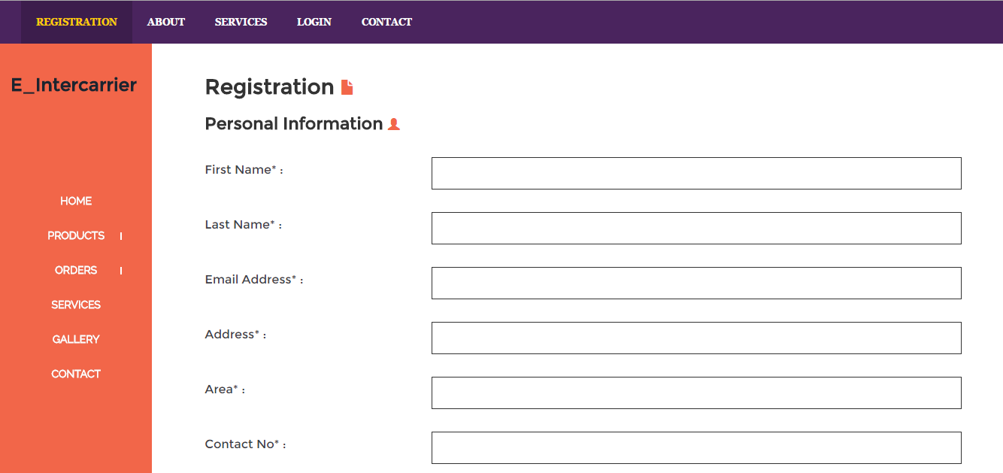

Slide 19
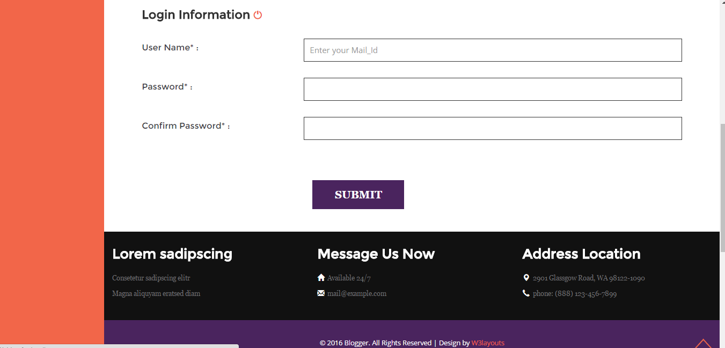

Slide 20
Store Login

Slide 21
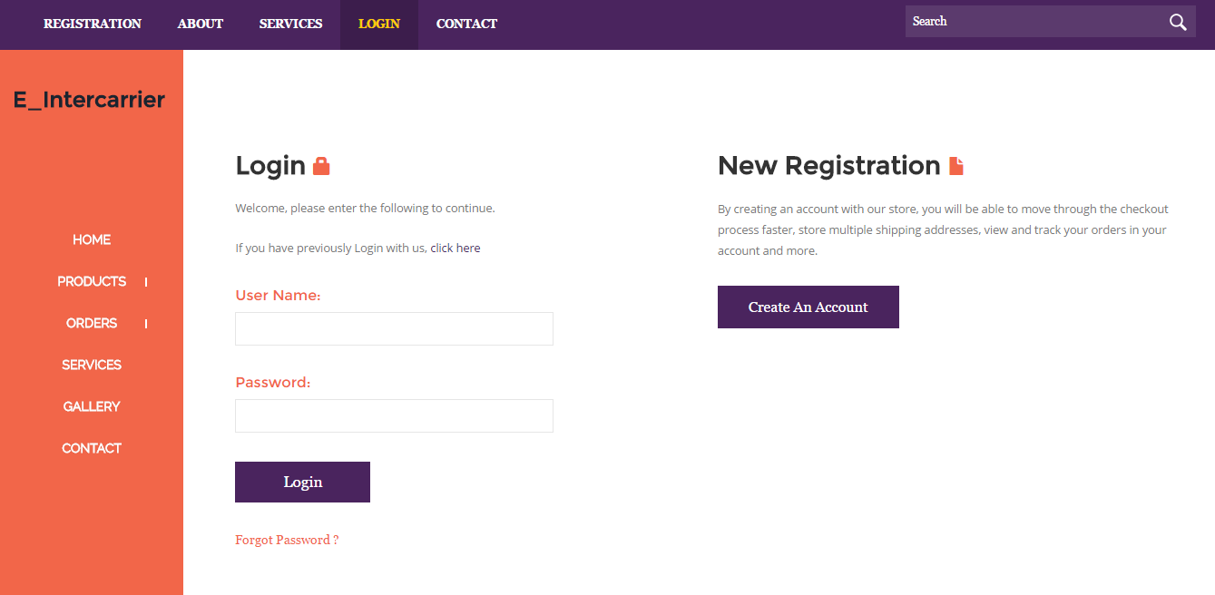

Slide 22
Store HomePage

Slide 23
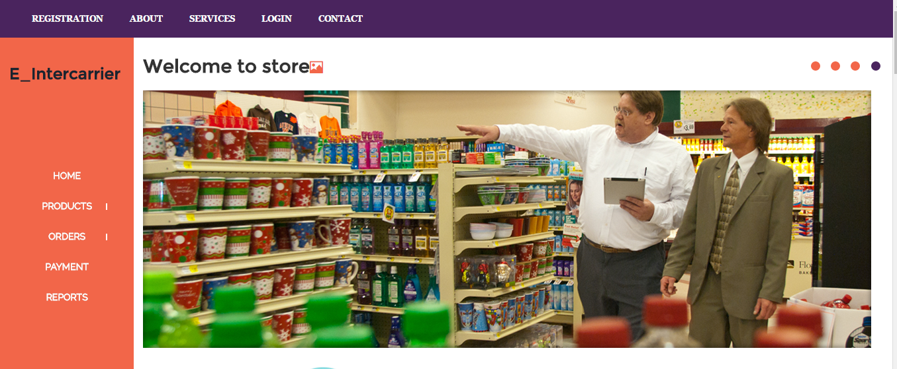

Slide 24
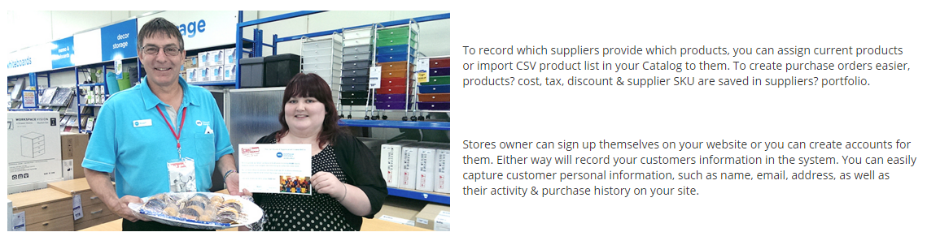

Slide 25
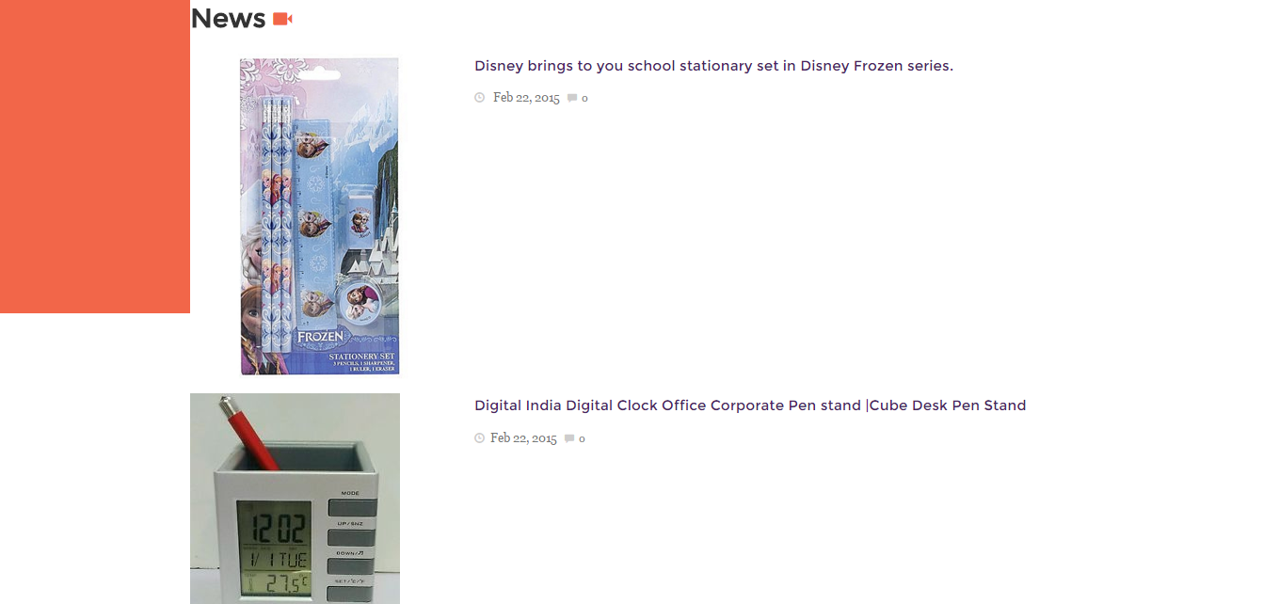

Slide 26
Store Products

Slide 27
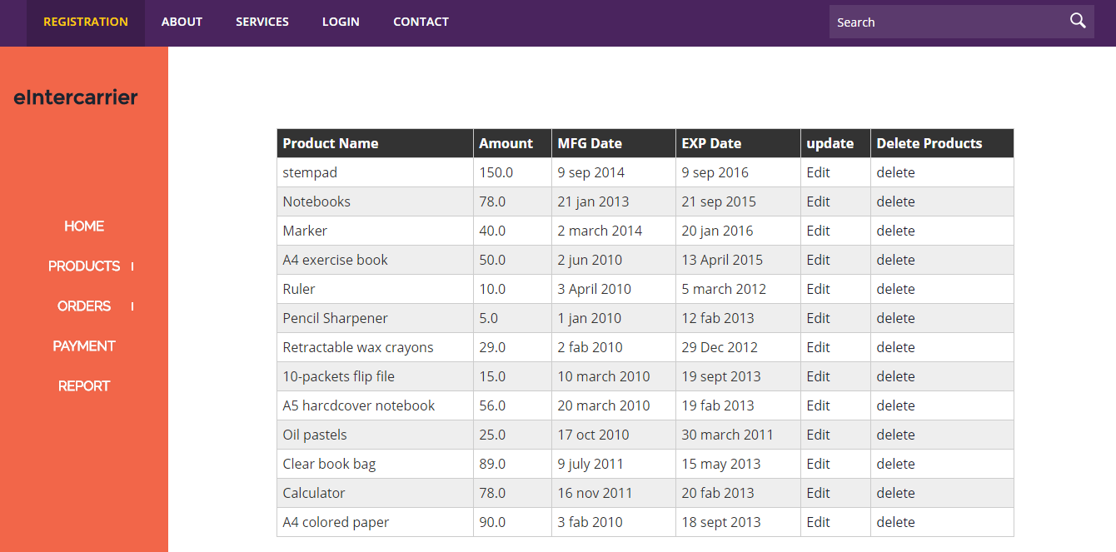

Slide 28
Add Products

Slide 29
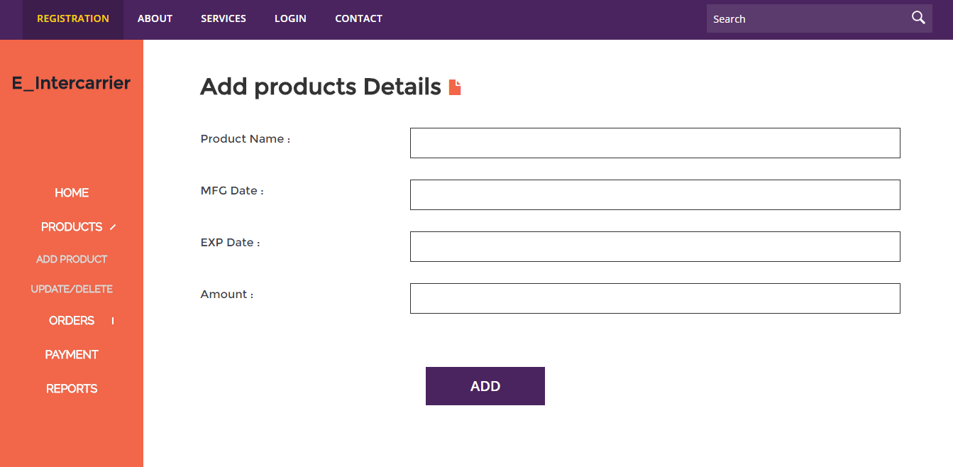

Slide 30
Update Products

Slide 31
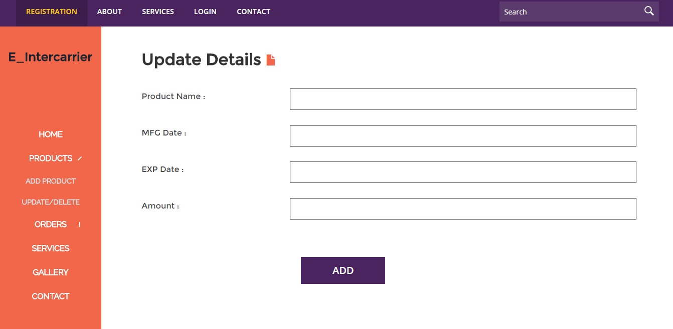

Slide 32
Place Order

Slide 33
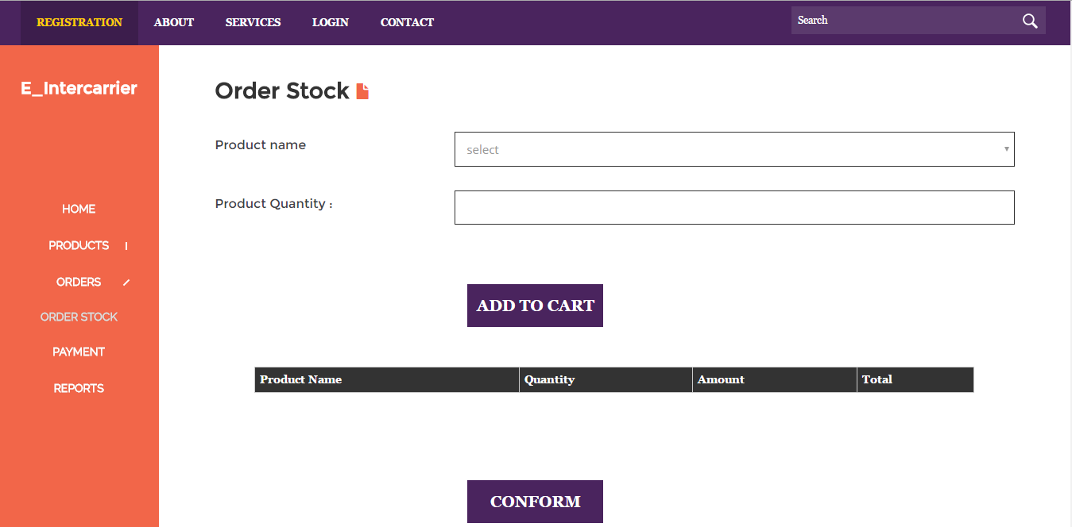

Slide 34
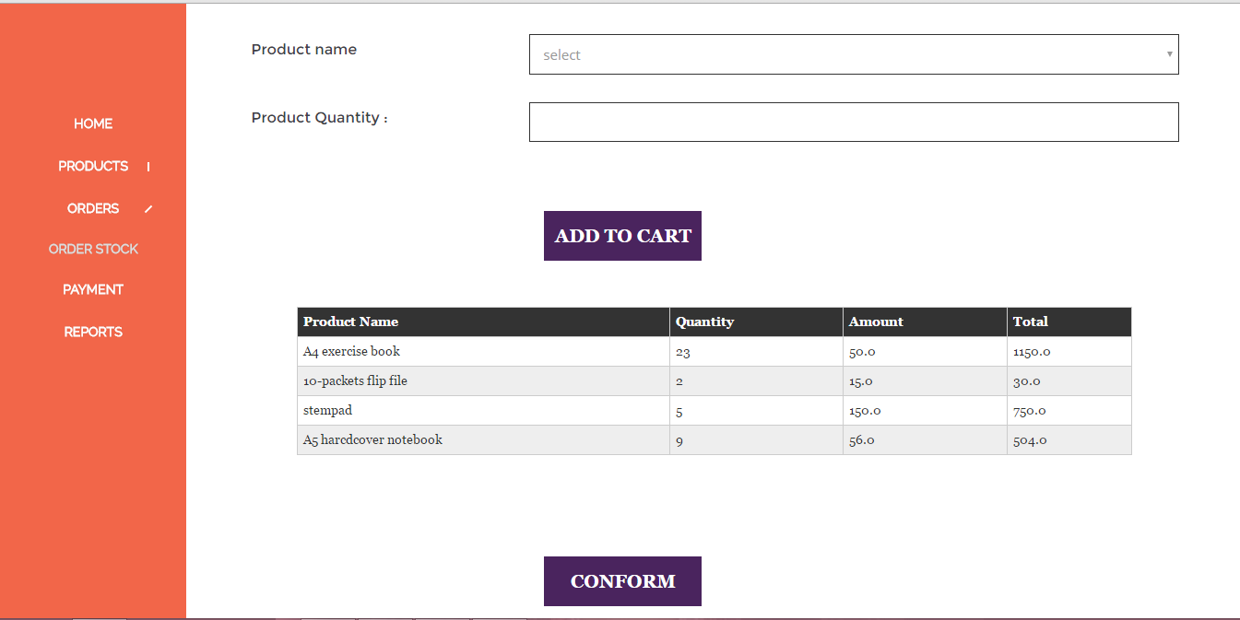

Slide 35
Warehouse WebPages
Login Page

Slide 37
Warehouse HomePage

Slide 38
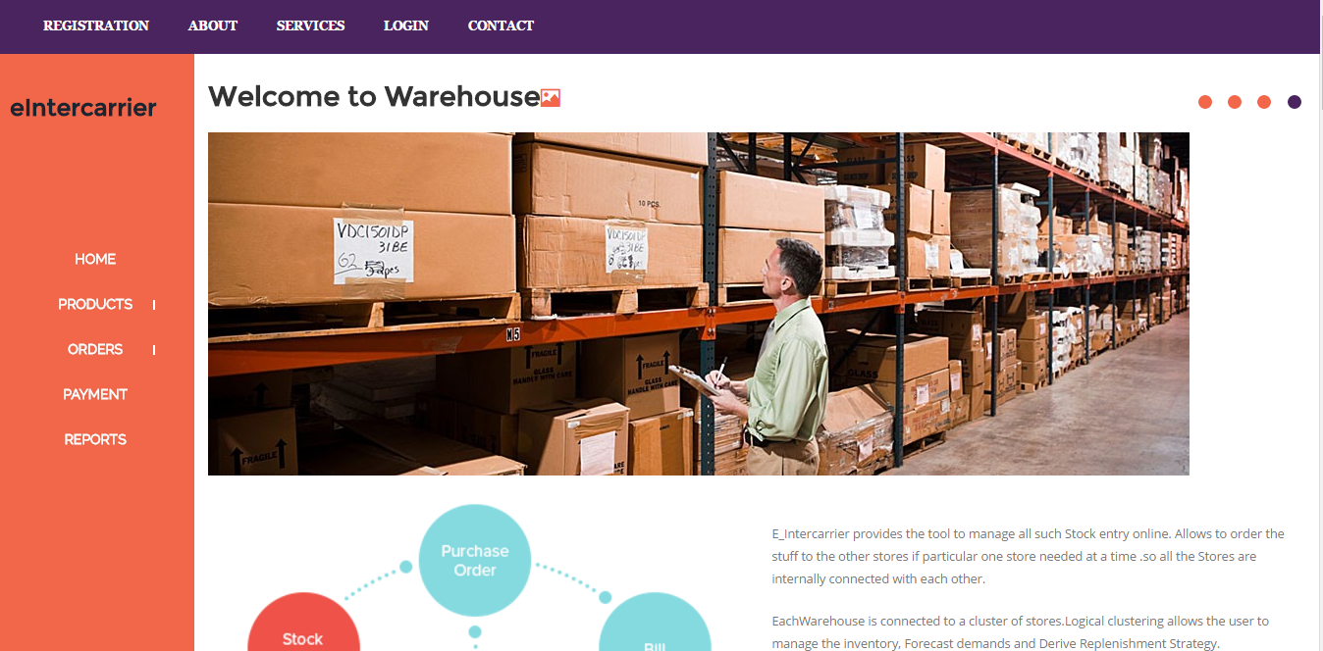

Slide 39
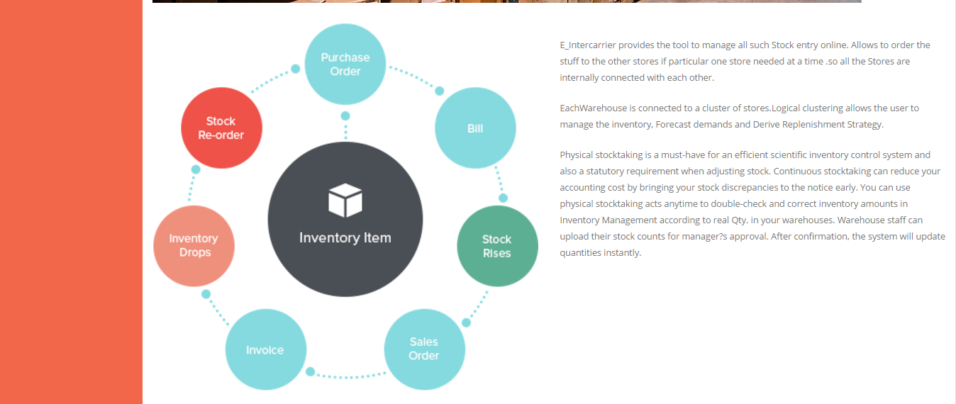

Slide 41
Warehouse Products

Slide 43
Add Products

Slide 44
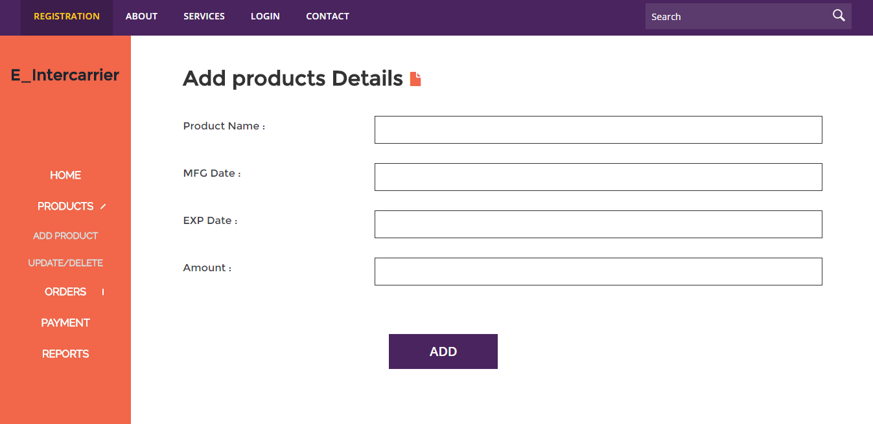

Slide 45
Update Products

Slide 47
Delete Products

Slide 49
View Orders

Slide 50
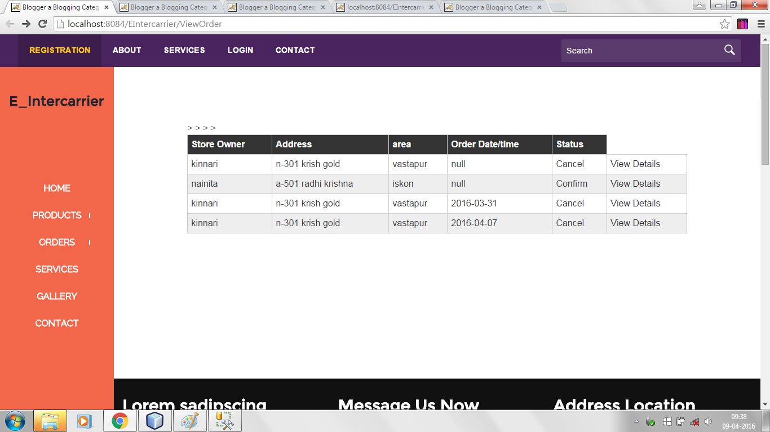

Slide 51
ON View Details Click

Slide 52
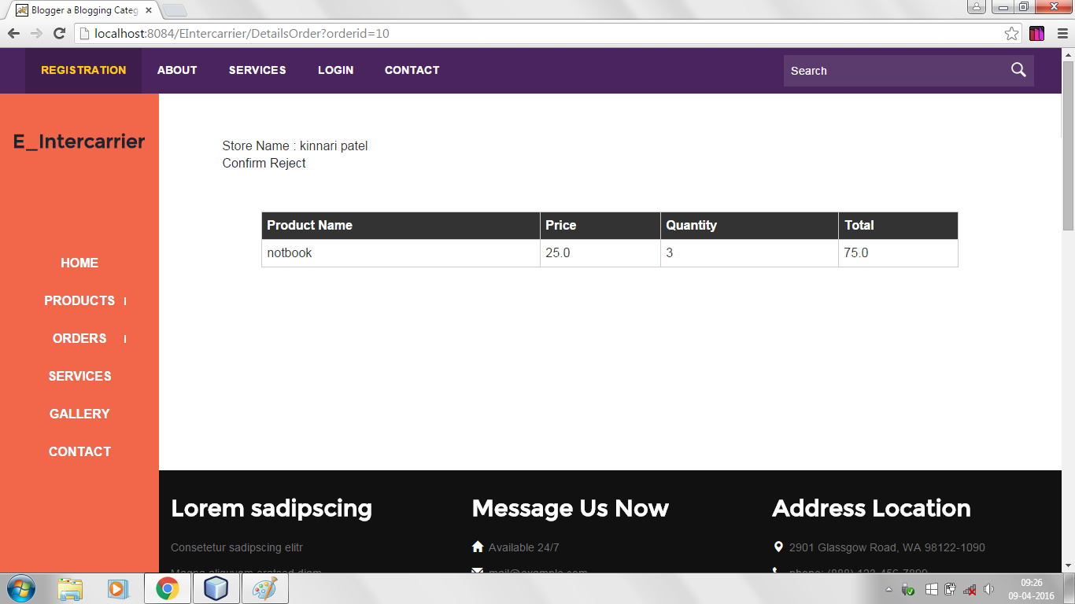

Slide 53
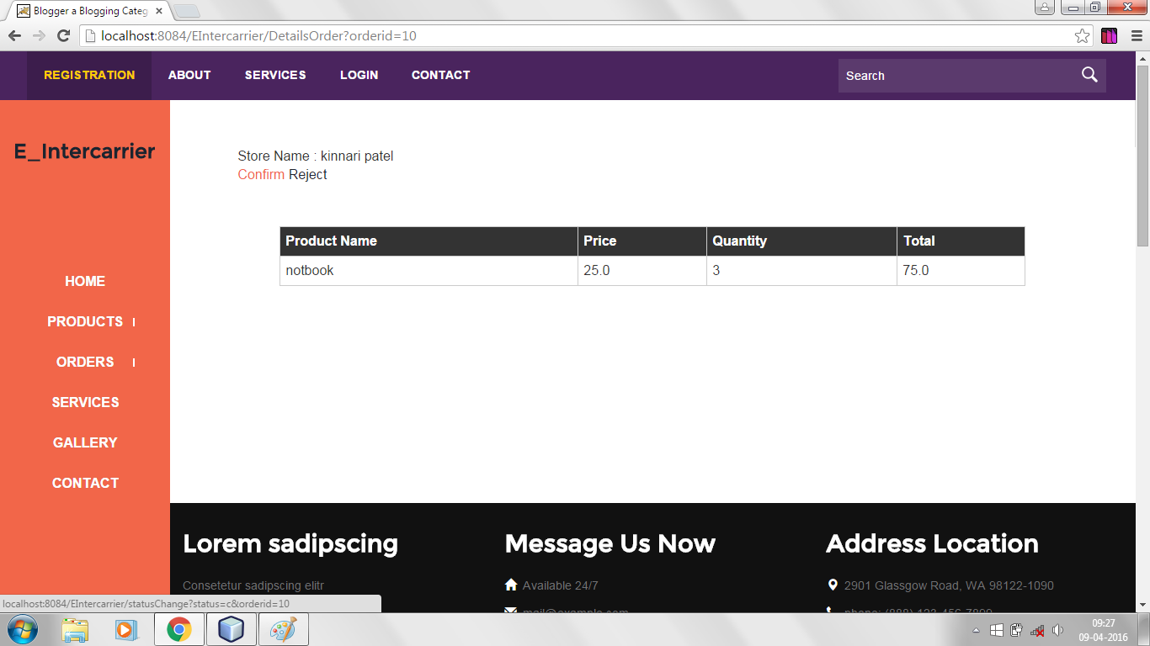

Slide 54
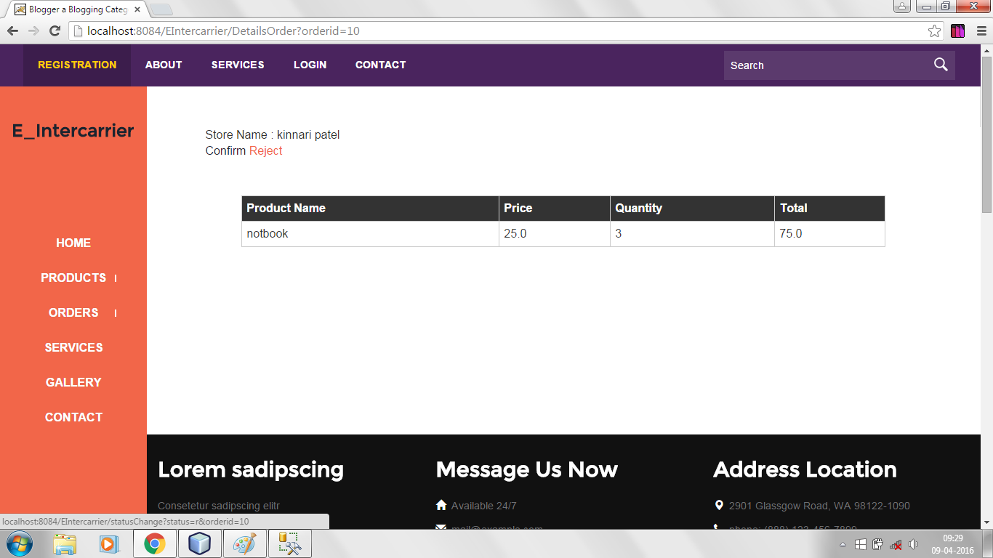

Slide 55
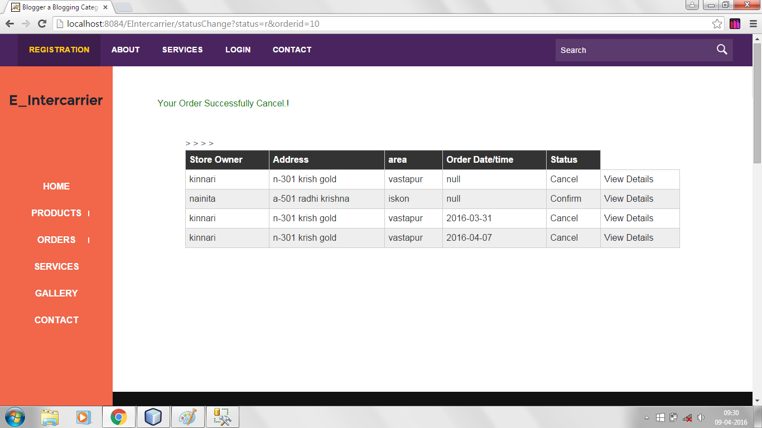

Slide 56
Admin
Admin Homepage

Slide 57
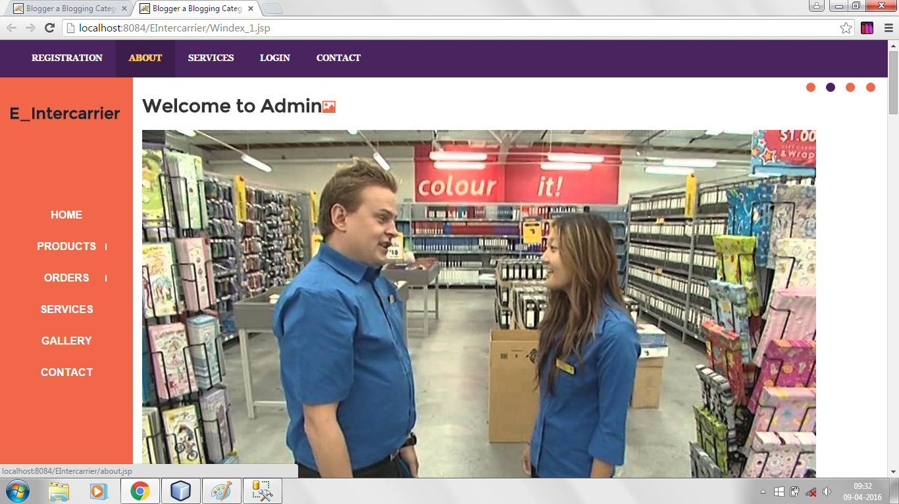

Slide 59
Remaining Work
Payment and Report Module Will Be added After .
Filtering Will Apply On the Project.
And Store To Store JSP Remaining.

Slide 60
Thank You

